Slide 1

Design of Compilers

Slide 2
Project Details Link:
https://drive.google.com/drive/folders/14UzBi4K6EyazFc9ZWnFLAd4LmxCGH7AQ?usp=sharing

Slide 3
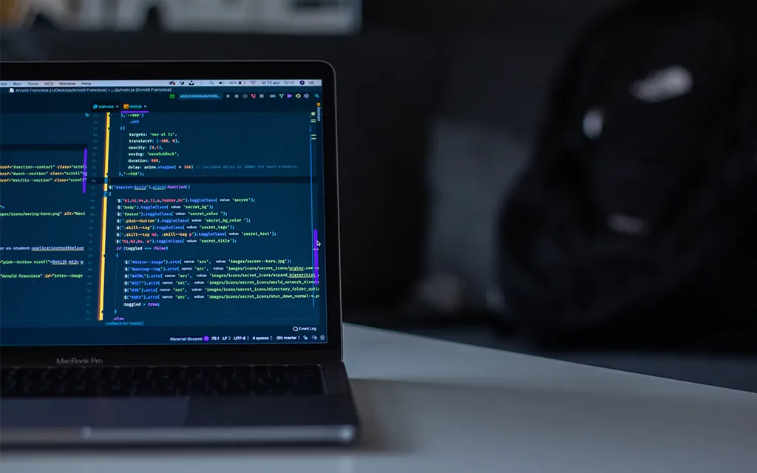
Team Members
Amr Naguib 21P0055
Mohamed Raslan 19P7975
Yasmina Nasser 21P0211
Youssef Salah 21P0159
Zeyad Mazen 21P0248

Slide 4
Table of Contents
Phase I
Lexer
Phase II
Parser
Parse Tree

Slide 5
Phase I Lexer

Slide 6
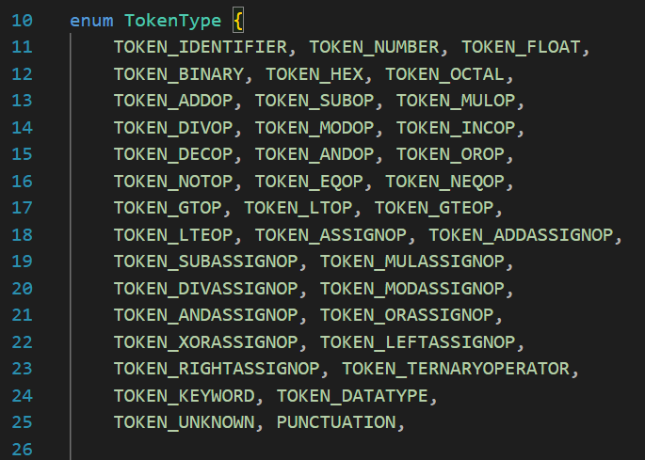
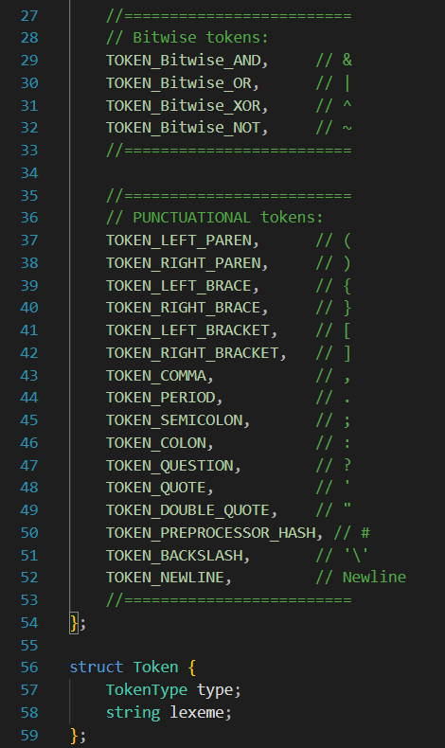
Lexer Defined Tokens
Numeric Tokens
Assignment Operators
Arithmetic Operators
Ternary Operator
Keywords and Datatypes
Bitwise Operators
Logical Operators
Unknown Tokens
Relational Operators
Punctuation

Slide 7
Lexer Classes
Lexer Regex
Lexer

Slide 8
Class Lexer Regex
Match Unary Operator
Match Relational Operator
Match Logical Operator
Match Bitwise Operator
Match Assignment Operator
Match Binary Operator
Match Ternary Operator

Slide 9
Class Lexer Regex
Match Keyword
Match Datatype
Match Float
Match Binary
Match Hex
Match Oct
Match Punc

Slide 10
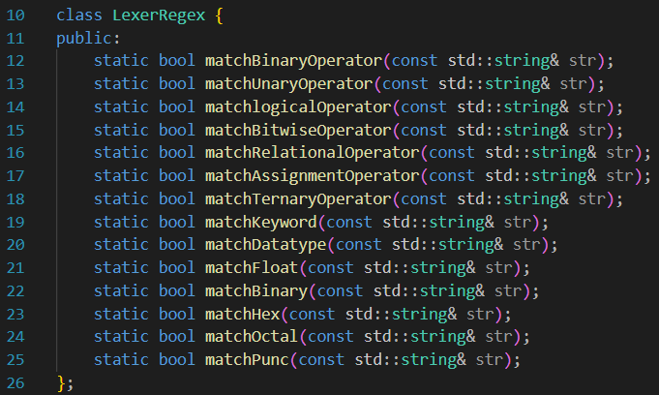
Class Lexer Regex

Slide 11
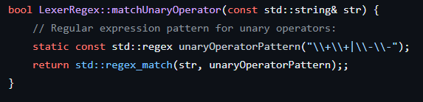
Class Lexer Regex
Match Unary Operator
Checks if the input string matches a unary operator pattern.
Returns true if the string matches, false otherwise.

Slide 12
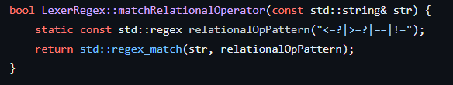
Class Lexer Regex
Match Relational Operator
Defines a function matchRelationalOperator within the LexerRegex class.
Uses a regular expression pattern to check if the input string matches any relational operator ("<", "<=", ">", ">=", "==", "!=").

Slide 13
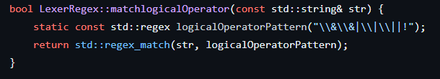
Class Lexer Regex
Match Logical Operator
Defines a method matchLogicalOperator within the class LexerRegex.
Uses a static regular expression pattern to check if the input string matches logical operators (`&&`, `||`, or `!`), returning a boolean result.

Slide 14
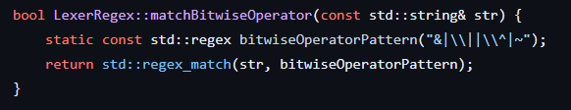
Class Lexer Regex
Match Bitwise Operator
Defines a regular expression pattern for bitwise operators: "&", "|", "^", or "~".
Checks if the input string matches this pattern and returns a boolean result.

Slide 15
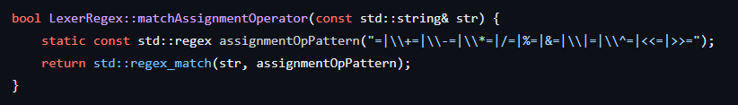
Class Lexer Regex
Match Assignment Operator
Checks if the input string matches any assignment operator pattern.
Returns a boolean indicating whether a match is found or not.

Slide 16
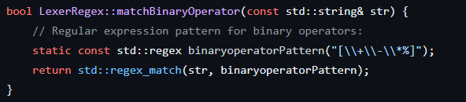
Class Lexer Regex
Match Binary Operator
Defines a function named matchBinaryOperator within the LexerRegex class.
Checks if the input string matches a predefined pattern of binary operators (+, -, *, %).

Slide 17
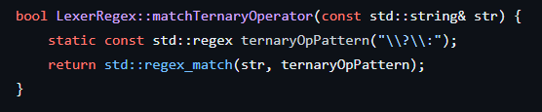
Class Lexer Regex
Match Ternary Operator
Defines a method matchTernaryOperator within class LexerRegex.
Checks if the input string matches the ternary operator pattern (?:).

Slide 18
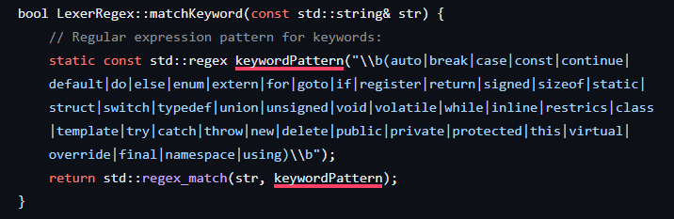
Class Lexer Regex
Match Keyword
Defines a regular expression pattern for matching keywords in a given string.
Utilizes the pattern to check if the provided string matches any keywords defined in the regular expression.

Slide 19
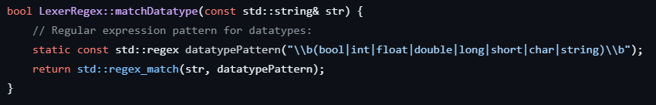
Class Lexer Regex
Match Data Type
Checks if the given string matches a specific datatype pattern.
Returns true if the string matches the pattern, false otherwise.

Slide 20
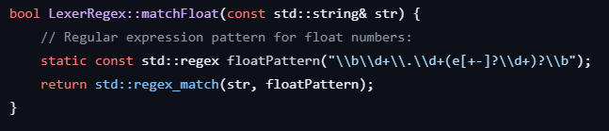
Class Lexer Regex
Match Float
Defines a function `matchFloat` within the LexerRegex class.
Uses a regular expression to determine if the input string represents a floating-point number.

Slide 21
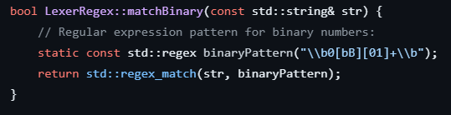
Class Lexer Regex
Match Binary
Defines a function matchBinary within the LexerRegex class.
Uses a static regular expression pattern to match binary numbers in a given string.

Slide 22
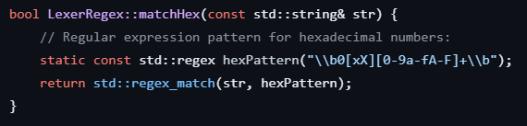
Class Lexer Regex
Match Hex
Defines a method matchHex within the class LexerRegex.
Uses a regular expression pattern to check if the provided string contains a hexadecimal number prefixed with "0x" or "0X".

Slide 23
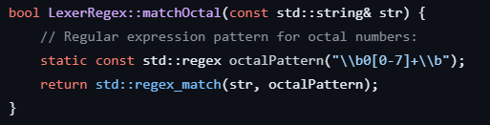
Class Lexer Regex
Match Oct
Defines a function matchOctal within class LexerRegex to check if the input string contains octal numbers.
Utilizes a regular expression pattern to match octal numbers starting with a zero followed by digits ranging from 0 to 7.

Slide 24
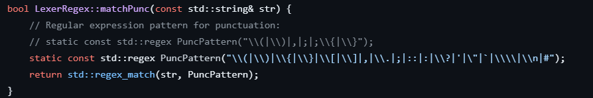
Class Lexer Regex
Match Punc
This class method checks if the input string matches a predefined set of punctuation characters using regular expressions.
It returns a boolean value indicating whether the input string contains punctuation.

Slide 25
End of Class Lexer Regex

Slide 26
Lexer Classes
Lexer Regex
Lexer

Slide 27
Class Lexer
Class Constructor
Get Next Token
Swap Buffers
Extract Lexemes
Is Delimeter
Handle Token

Slide 28
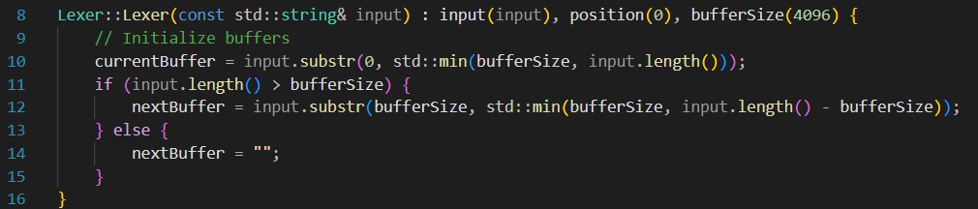
Class Lexer Regex
Class Constructor
Constructs a Lexer object with an input string, initializing internal variables.
Sets up buffers for processing the input string, dividing it into current and next buffers.

Slide 29
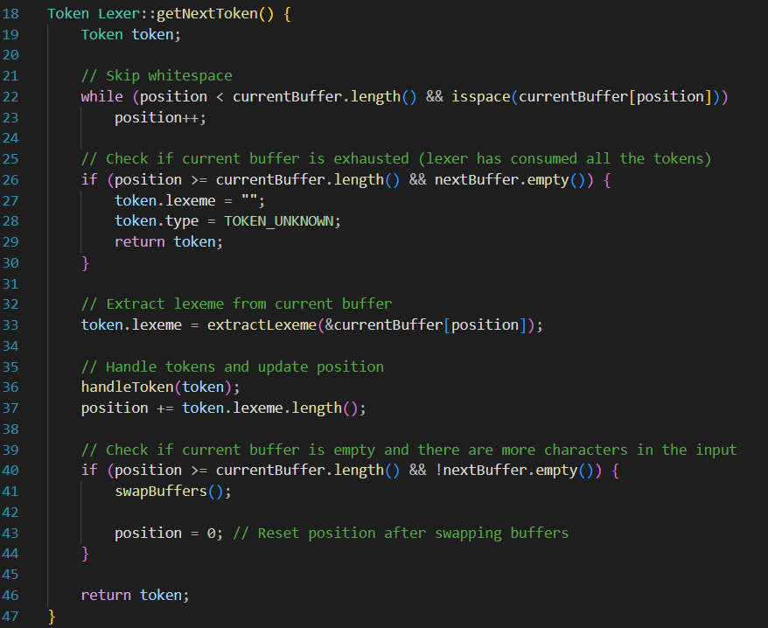
Class Lexer Regex
Get Next Token
The getNextToken method of the Lexer class retrieves the next token from the input stream.
It skips whitespace, extracts the lexeme, handles tokens, and updates the position accordingly.

Slide 30
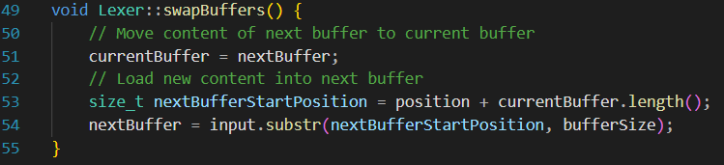
Class Lexer Regex
Swap Buffers
Swaps the current buffer with the next buffer.
Loads new content into the next buffer from a specified position in the input.

Slide 31
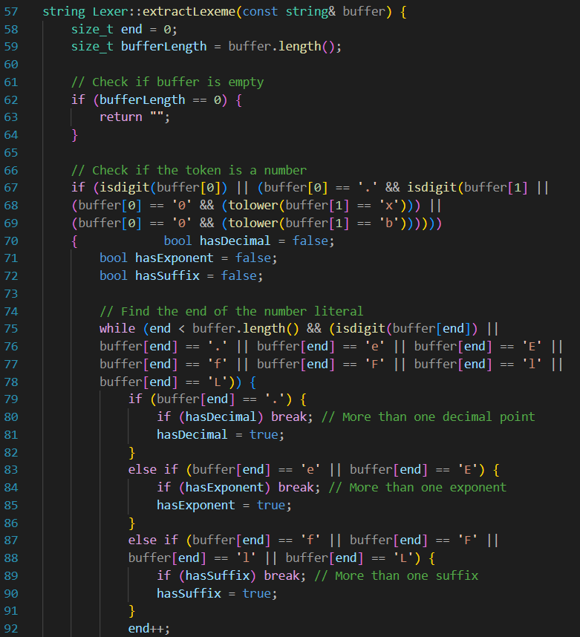
Class Lexer Regex
Extract Lexemes
The extractLexeme checks whether the token is a number by inspecting if the initial characters match the patterns of numeric literals, including integers, floating-point numbers, hexadecimal, and binary representations. It handles various cases such as numbers with decimal points, exponents, and suffixes indicating the type of number. If the token matches any of these patterns, the function identifies the end of the numeric literal by iterating through the buffer until the complete number is captured.

Slide 32
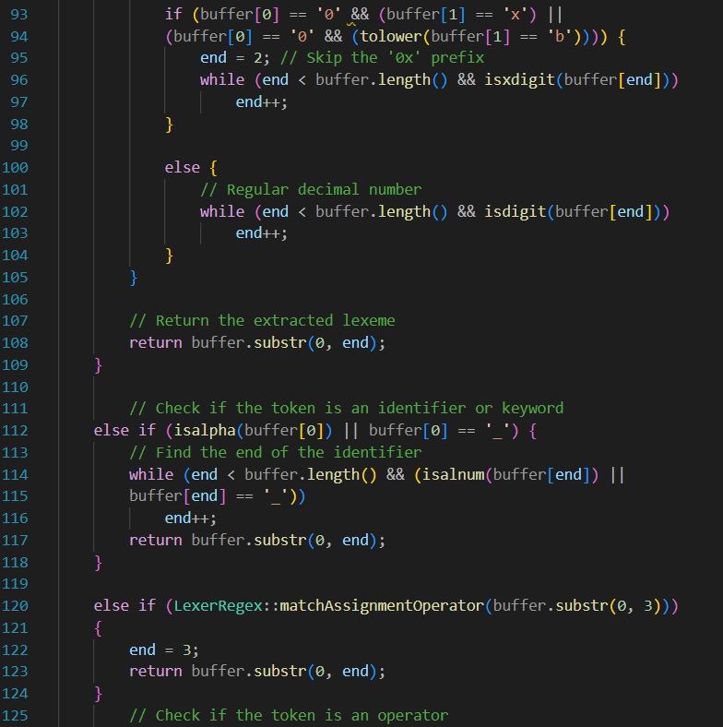
Class Lexer Regex
Extract Lexemes
Secondly, the function checks if the token is an identifier or a keyword by inspecting if the initial character is alphabetic or an underscore. It continues scanning the buffer until it reaches a character that doesnt belong to the identifier pattern, effectively extracting the entire identifier.

Slide 33
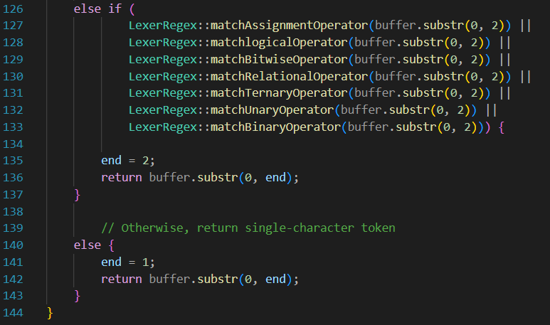
Class Lexer Regex
Extract Lexemes
Thirdly, it checks if the token is a multi-character operator by attempting to match it against predefined regular expressions representing assignment, logical, bitwise, relational, ternary, and unary operators. If a match is found, the function captures the operator, advancing the buffer position accordingly.
Finally, if none of the above patterns match, the function assumes the token is a single-character token, such as punctuation or special characters. It extracts the single character and returns it as the token.

Slide 34
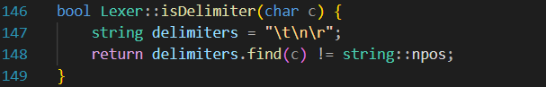
Class Lexer Regex
Is Delimeter
Determines if a character is a delimiter.
Compares the character with a predefined set of delimiters and returns true if it matches any.

Slide 35
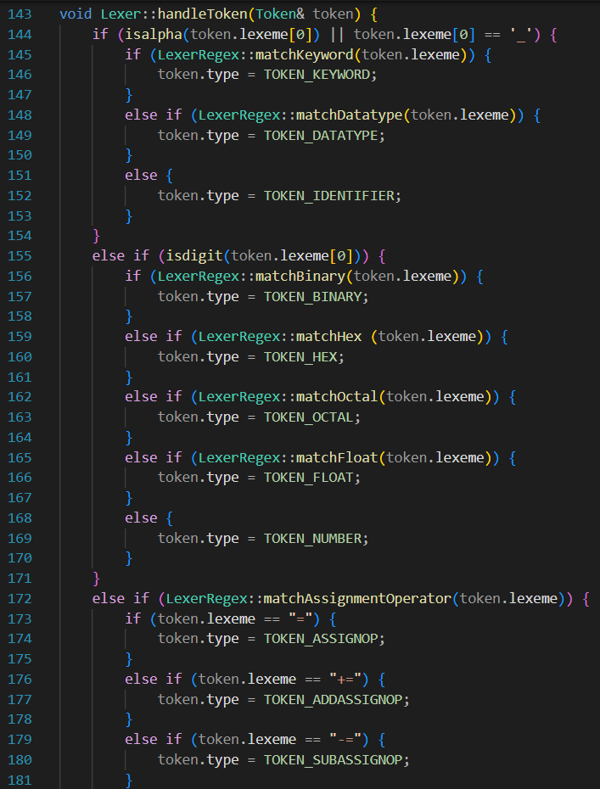
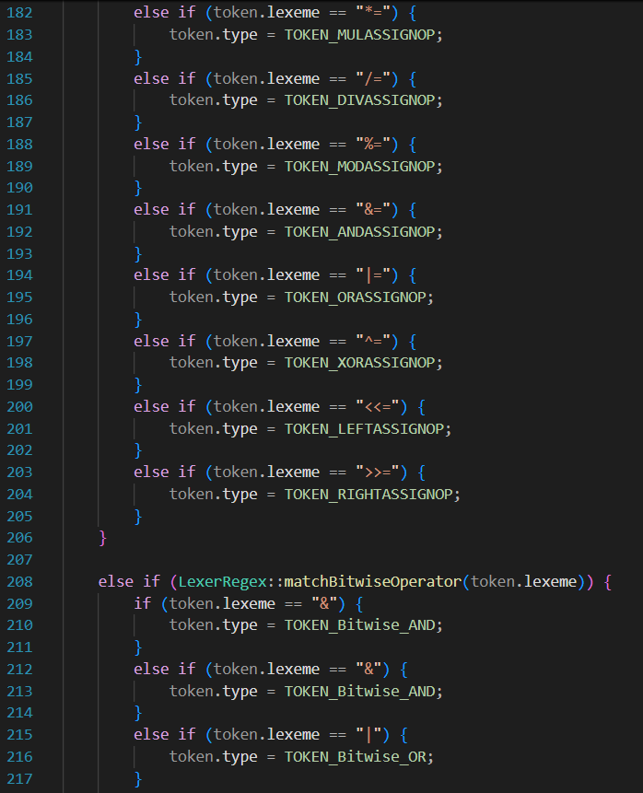
Class Lexer Regex
Handle Token

Slide 36
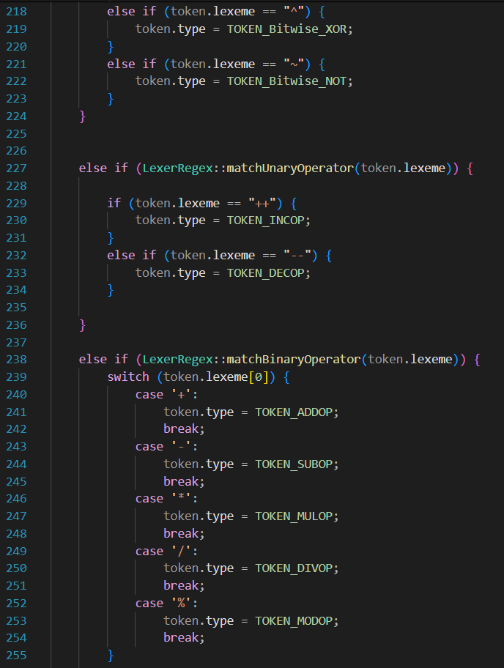
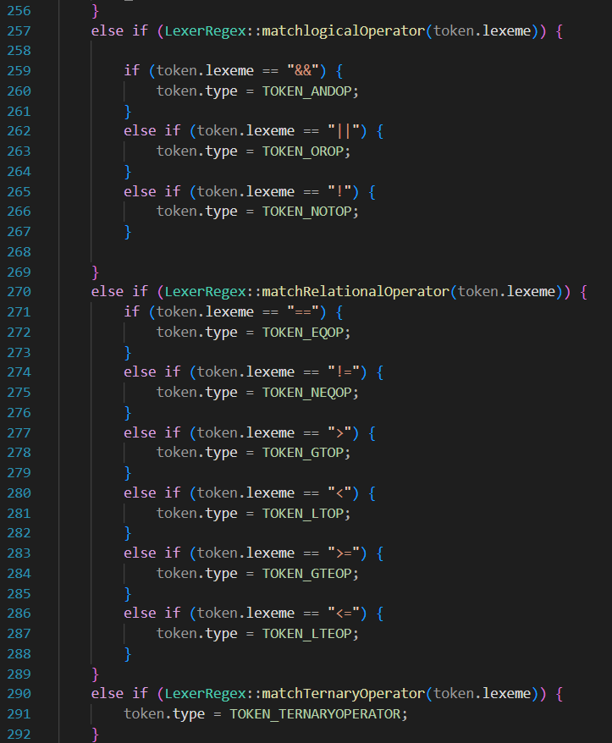
Class Lexer Regex
Handle Token

Slide 37
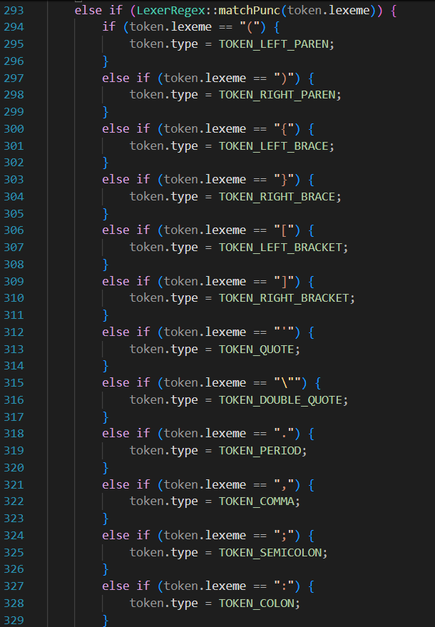
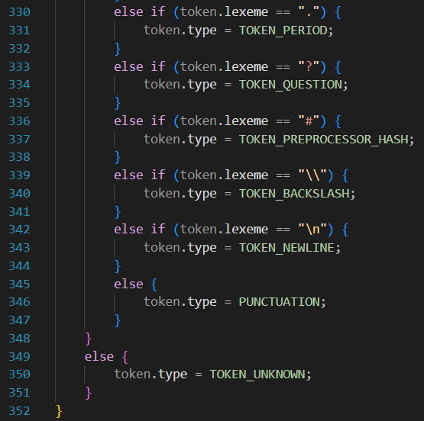
Class Lexer Regex
Handle Token

Slide 38
Lexer GUI

Slide 39
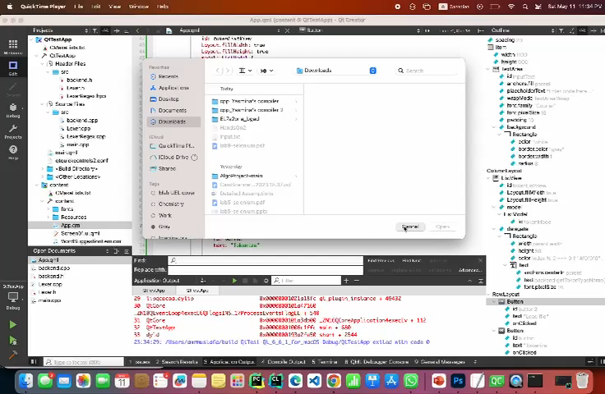
Lexer GUI

Slide 40
End of Class Lexer

Slide 41
Wait a Minute!
I Think We Forgot Something!

Slide 42
Testing Lexer

Slide 43
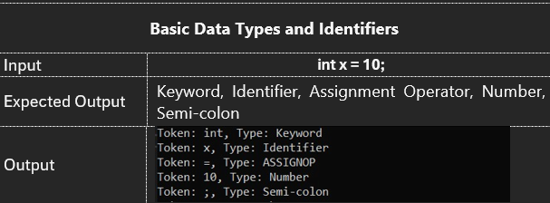
Test Case 1
SUCCESS

Slide 44
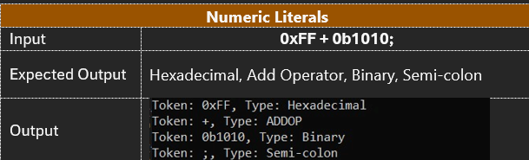
Test Case 2
SUCCESS

Slide 45
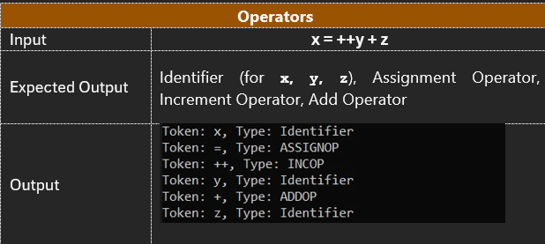
Test Case 3
SUCCESS

Slide 46
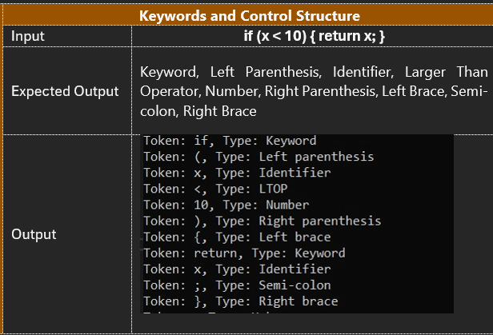
Test Case 4
SUCCESS

Slide 47
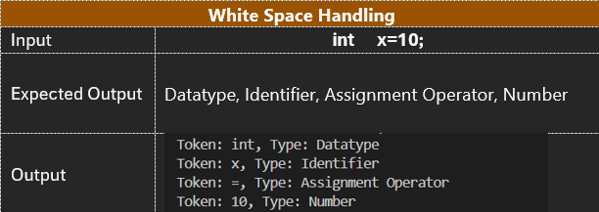
Test Case 5
SUCCESS

Slide 48
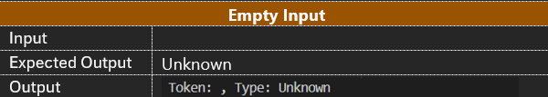
Test Case 6
SUCCESS

Slide 49
End of Lexer Implementation

Slide 50
Phase II Symbol Table

Slide 51
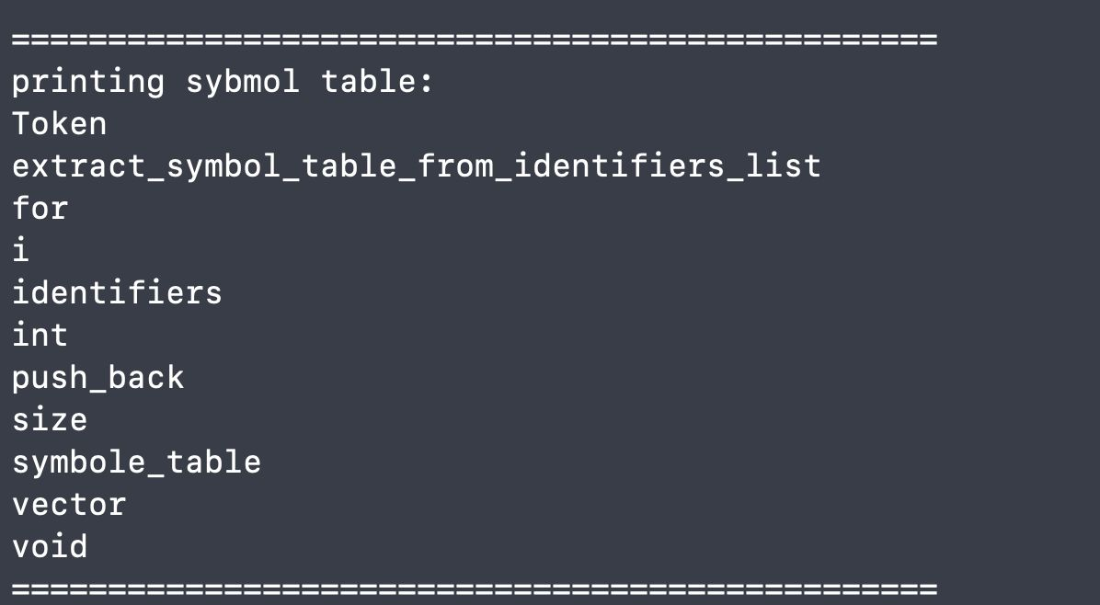
Symbol Table

Slide 52
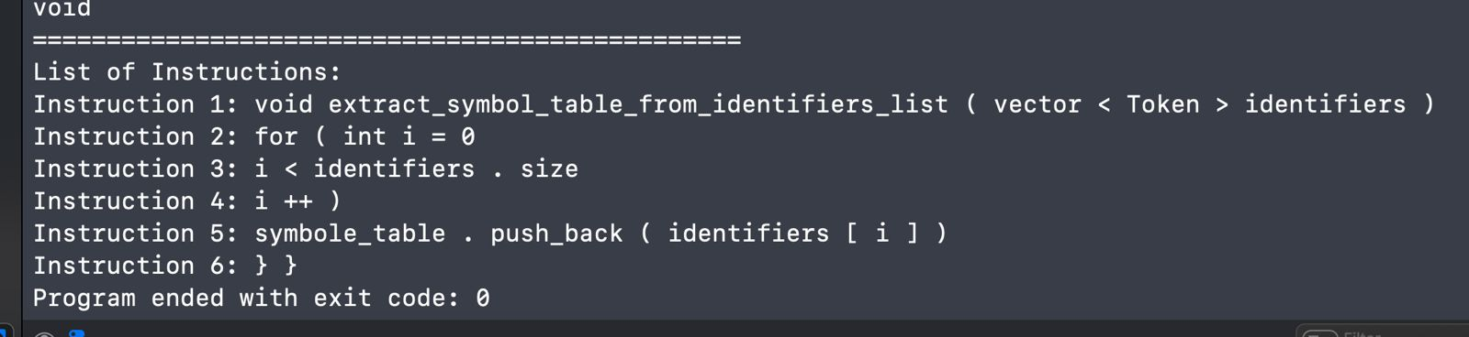
Symbol Table

Slide 53
Parser

Slide 54
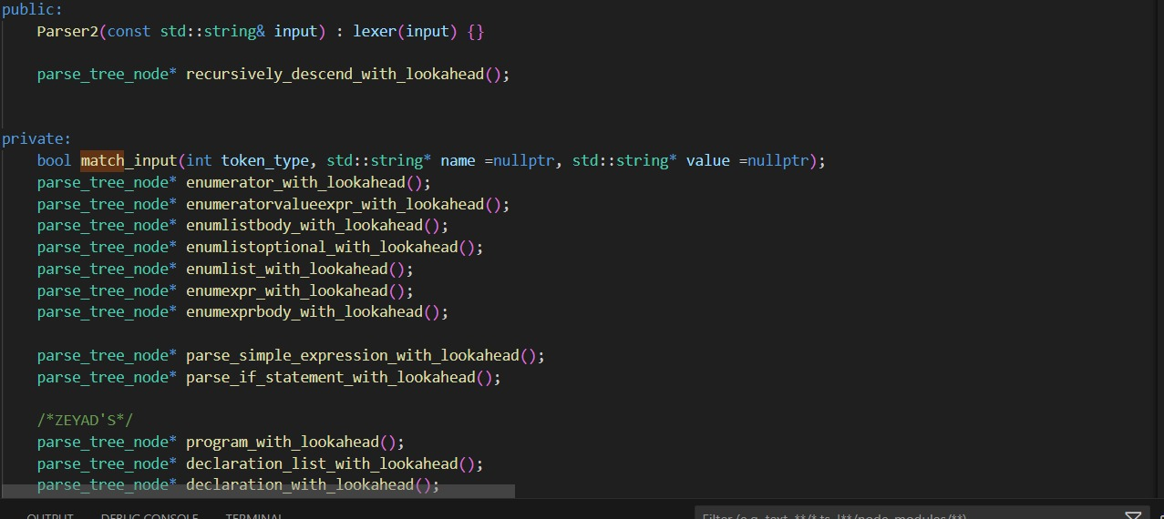
Parser

Slide 55
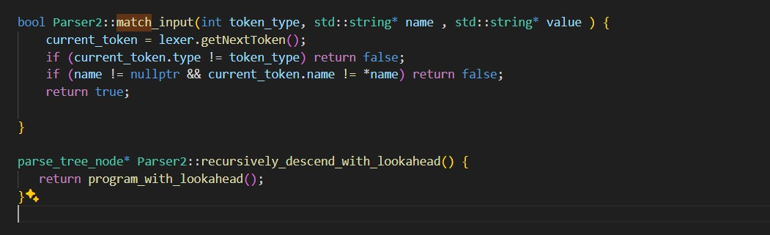
Parser

Slide 56
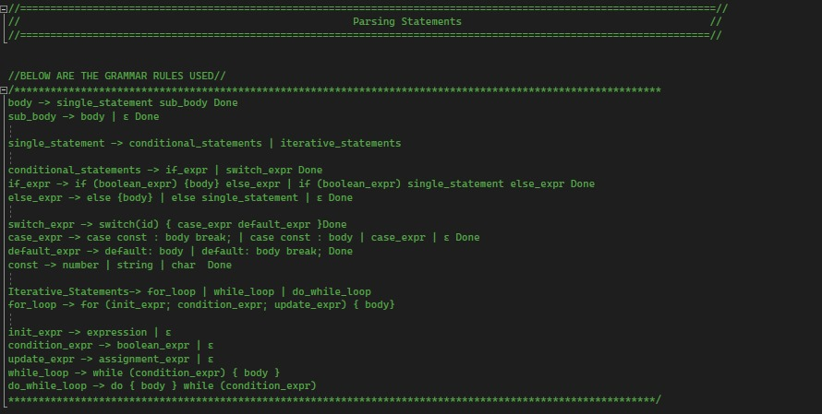
Statements

Slide 57
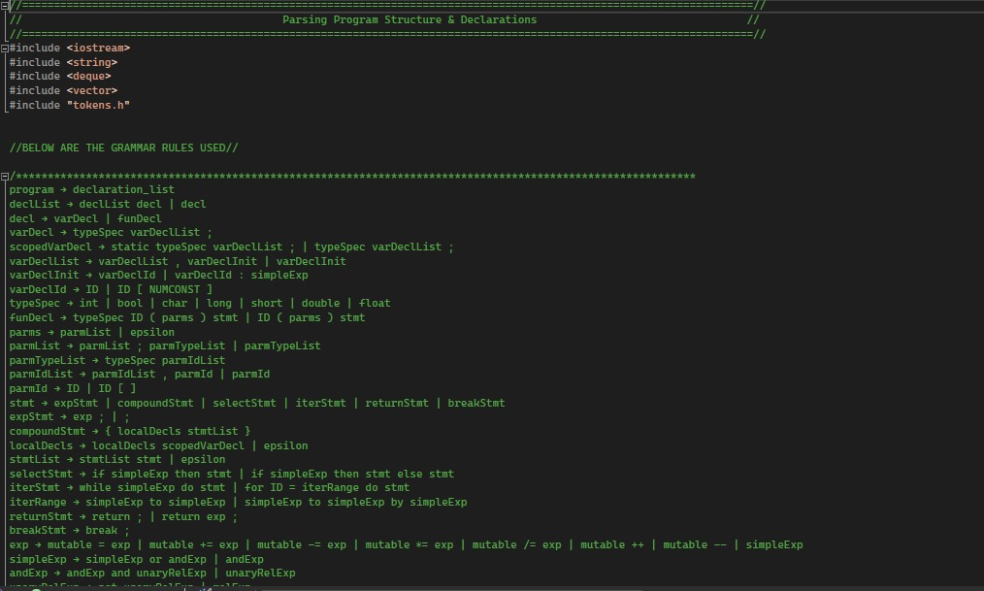
Program and Declarations

Slide 58
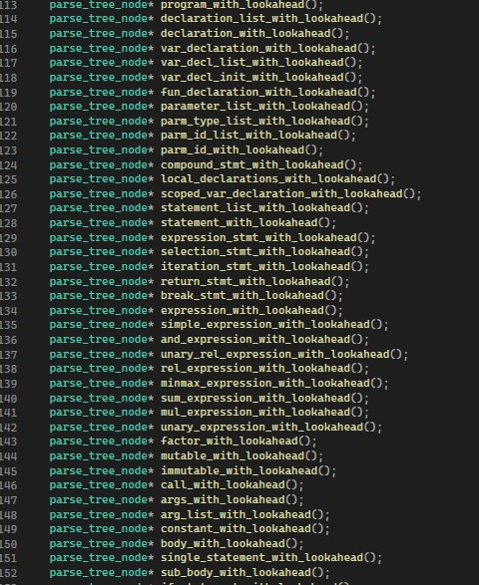
Recursive Functions

Slide 59
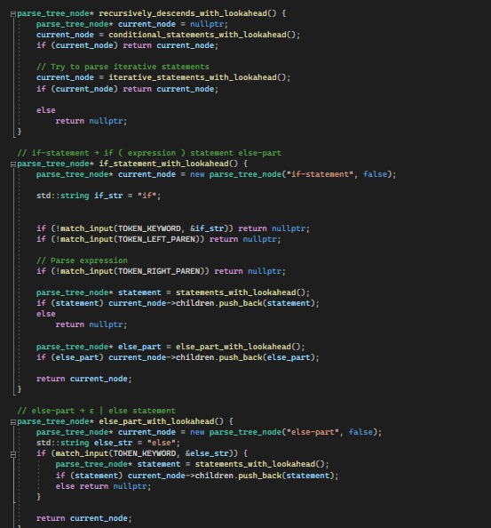
Recursion Implementation

Slide 60
Phase II
Parse Tree

Slide 61
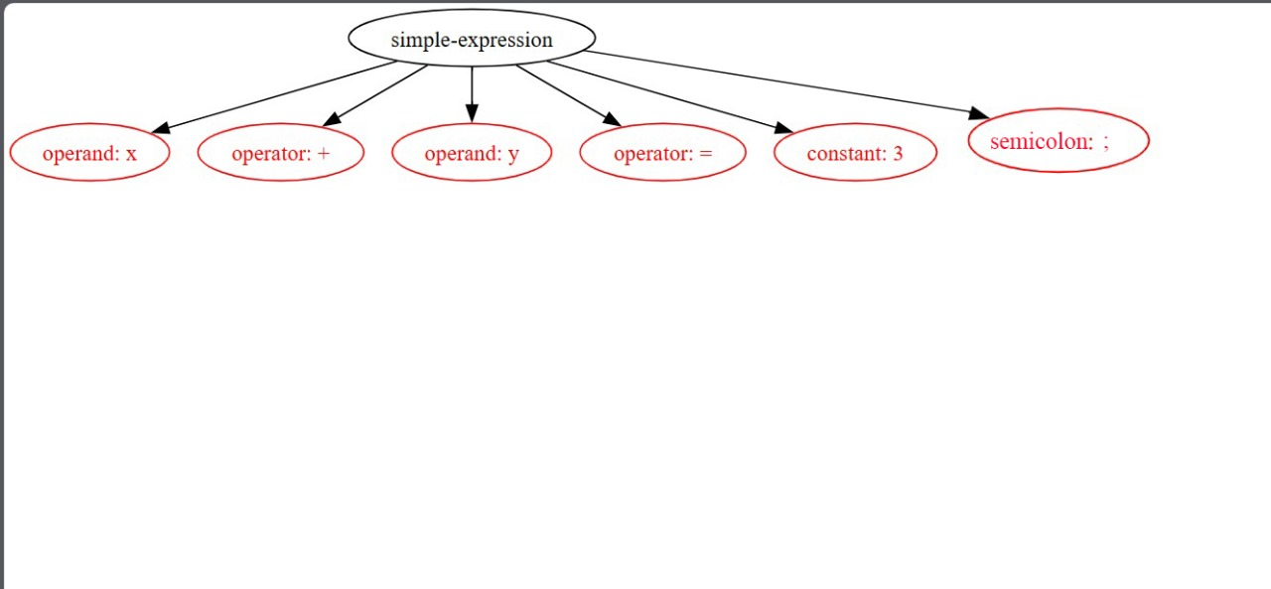
Parse Tree
Simple Expression

Slide 62
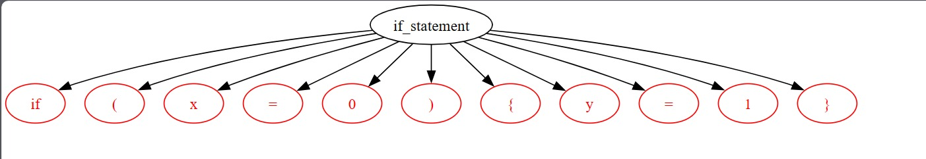
Parse Tree
If Statement

Slide 63
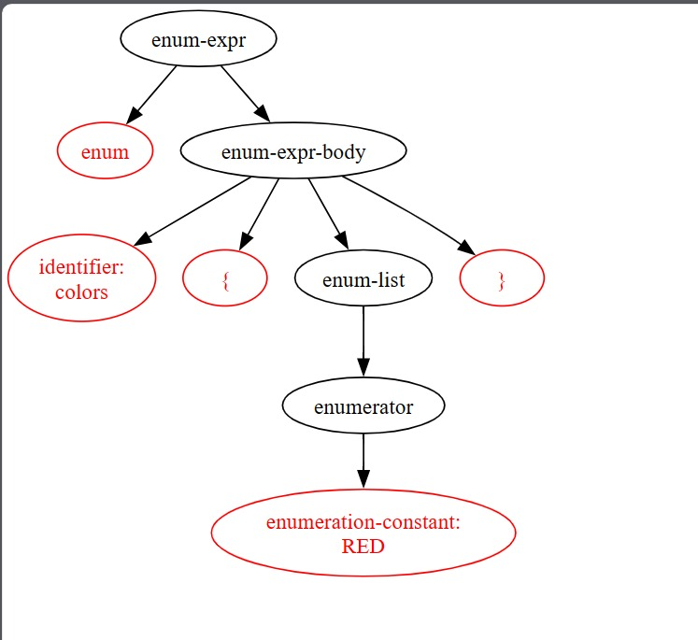
Parse Tree
Enum Statement

